Slide 1

DATA SCIENCE ON SUBSCRIPTION SERVICE
By: Mfon Ankoh
Data Science Internship Program, May 2023
Team Achievers
https://github.com/mfonobong-ankoh/Final_project.git

Slide 2
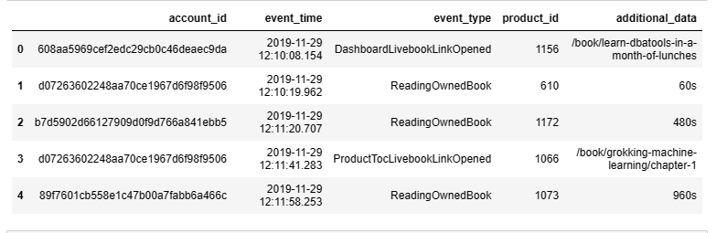
Summary of subscribers behavioural activities

Slide 3
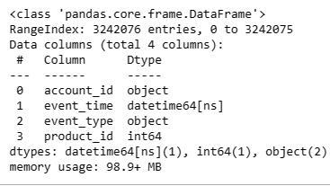
Data Preparation and Analysis
The column “additional_data” was dropped as it contained NaN
Afterwards, the data had 3242076 rows and 4 columns.
Fixed timestamps for ”event_time” by converting it to datetime data type
There were no missing data
From the data given ‘event_time’ was use to check for outliers as other variables were category variables

Slide 4



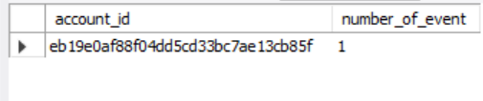
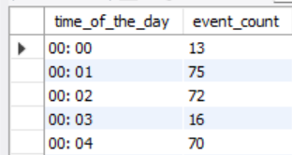
Analysing Customer Behaviour
From the anslysis carried out on the that most common event is ‘Readingownedbook’
The least common event is ‘UnknownOriginLivebookLinkOpened’ with count 1.
The ‘account id’ with the highest number of events is ‘caffe2b03e6057845c52212acaaa1a34’.
The ‘account id’ with the least number of event is ‘eb19e0af88f04dd5cd33bc7ae13cb85f’.
The number of times events occurred based on different times of the day was achieved by converting the “event_time” to time format as “time_of_the_day”

Slide 5
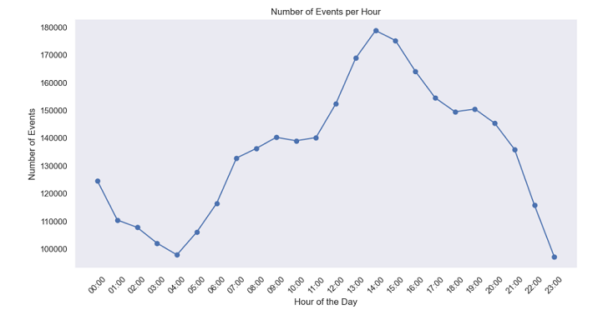
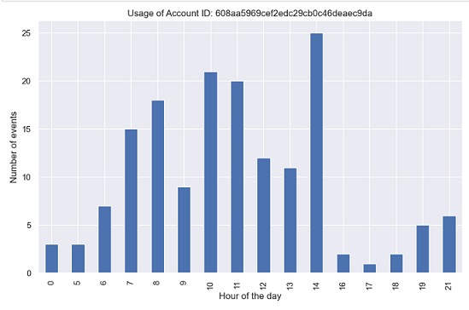
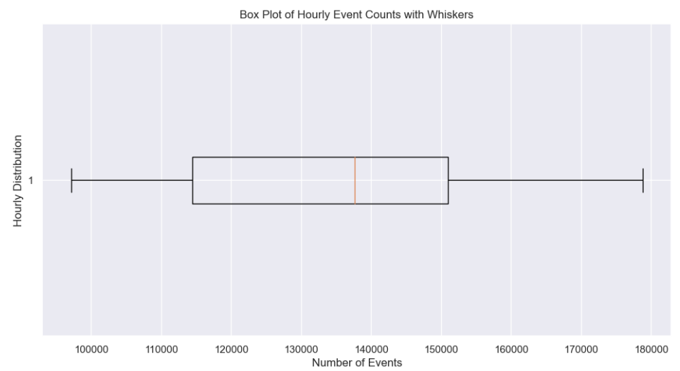
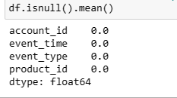
Data Quality Check
The line chart shows events do not happen equally at different times of the day
The ‘account_id’'608aa5969cef2edc29cb0c46deaec9da’ is more active at 14 hours and lest active between 16 to 18 hours
There are no missing data in the record of any events
There are no extreme outliers in the number of events

Slide 6
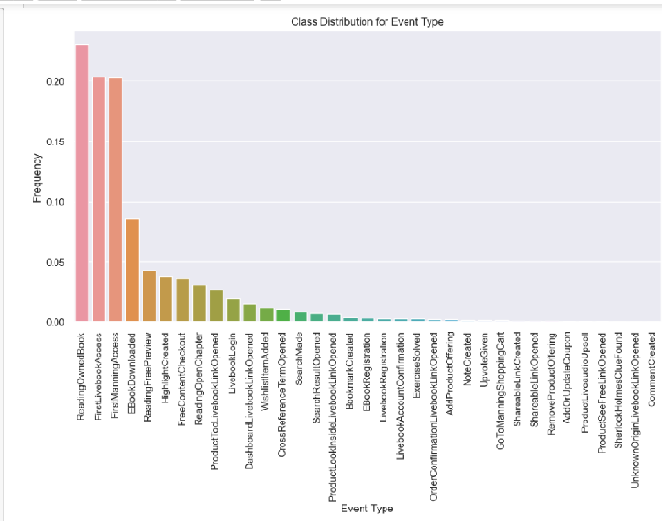
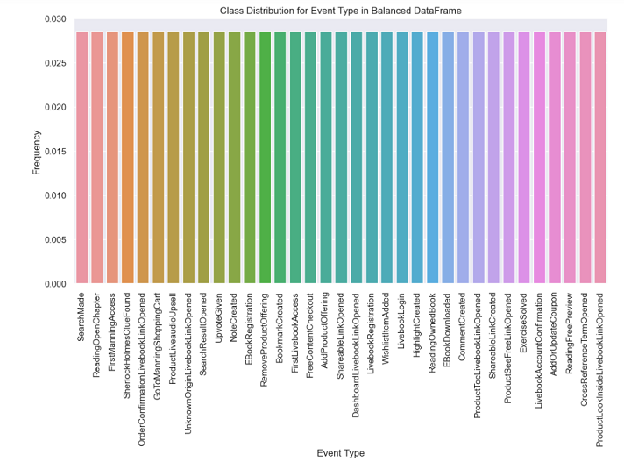
Fixing Bad Data
In the ‘event_type’ a class imbalance was observed when the event frequency was analyzed
This was fixed using a combination of oversampling and undersampling since the data was categorical

Slide 7
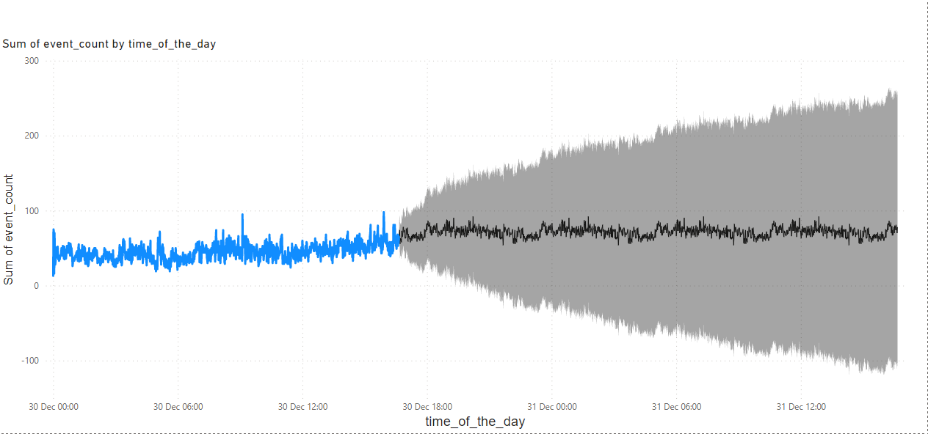
Forecasting the Next Event Time
A line chart was used to plot event_time on the X-axis and the event_type on the Y-axis.
Forecasting line predicts the next trend of the next event time

